Slide 1

SCHOOL OF ELECTRICAL AND ELECTRONICS ENGINEERING (SEEE)
CAPSTONE PROJECT PHASE-2
2021-2025 BATCH
Automatic Speech Recognition System of Low Resource Malvi Language
GROUP MEMBERS :
Laxmi Parmar (21BAC10033)
Rakesh Lodhi (21BAC10034)
SUPERVISOR NAME:
Dr. Anirban Bhowmick
Date : 12 March 2025

Slide 2
PHASE-1
Short Recap

Slide 3





Introduction
अरे नि यार कक्कू! पानत करबा जारियो, माल में घनी तराड़ा पाड़ री, अने अबरके बोर और उतर गियो।
कनंग जारियो नाना? माल में भारा लेबा जारियो कई

Slide 4





Introduction
Low-resource language: Spoken mainly in villages among farmers and rural communities.
Over 5.4 Million People
Western Madhya Pradesh and southeastern Rajasthan
Historical and cultural significance with influences from various dynasties.

Slide 5
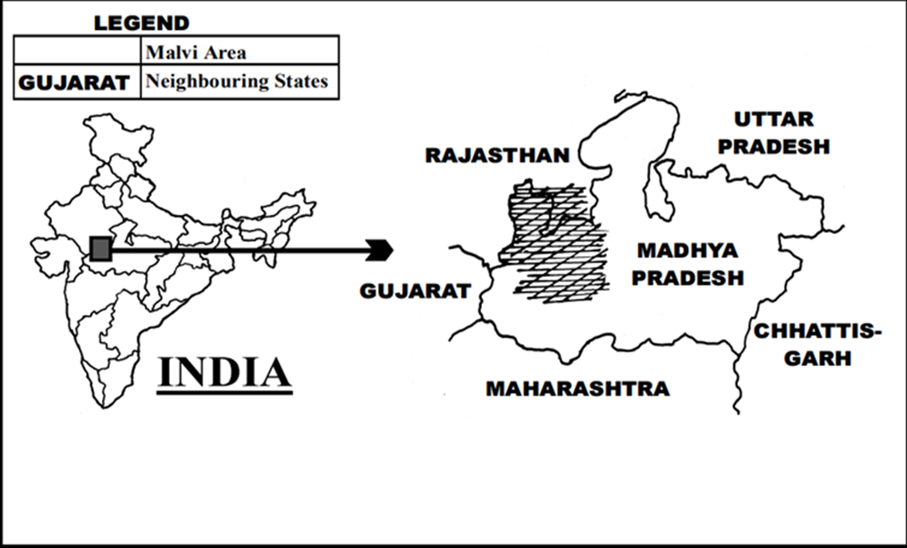
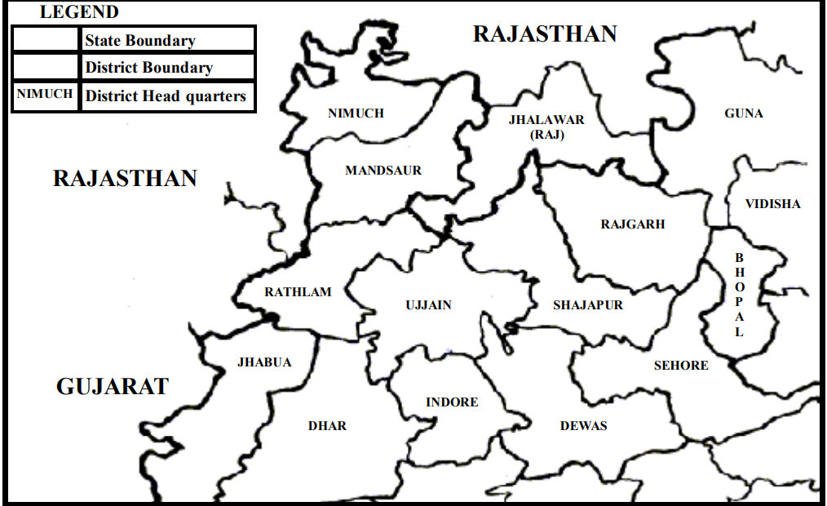

Malwa Region
DISTRICT OF MALWA
In Madhya Pradesh, Malvi is spoken primarily in the Malwa region, consisting of districts such as Ujjain, Ratlam, Indore, Dewas, Shajapur, Mandsaur, Neemuch, Rajgarh, Sehore, Dhar, and Bhopal.
In Rajasthan, the language is spoken in the districts of Jhalawar, eastern Pratapgarh, Banswara, and Kota.

Slide 6
Malvi
Malvi is a mother tongue grouped under the Hindi language family.
Malvi Language: Indo-Aryan language spoken in the Malwa region of India.
Script: Written in Devanagari, read from left to right.
Related Languages: Closely related to Nimadi and part of the Rajasthani language group.
Influences: Influenced by Rajasthani, with traces of Gujarati and Marathi,about 75% of the population of Malwa can converse in Hindi.
Major dialects of Malvi include Ujjaini, Rajawadi, Umadwadi, and Sondhwadi.

Slide 7
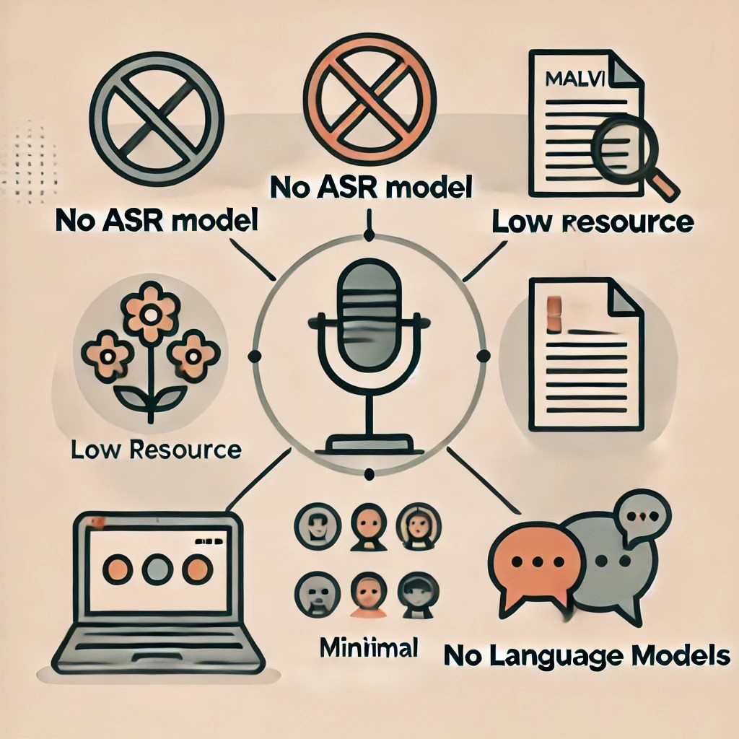
Problem Statement
No ASR Model: Malvi lacks an Automatic Speech Recognition (ASR) model.
Low Resource: Limited data and research; no annotated corpus available.
Minimal Digital Presence: Few technological tools or resources for Malvi online.
No Language Models: No pre-existing language models due to dialectical diversity.

Slide 8
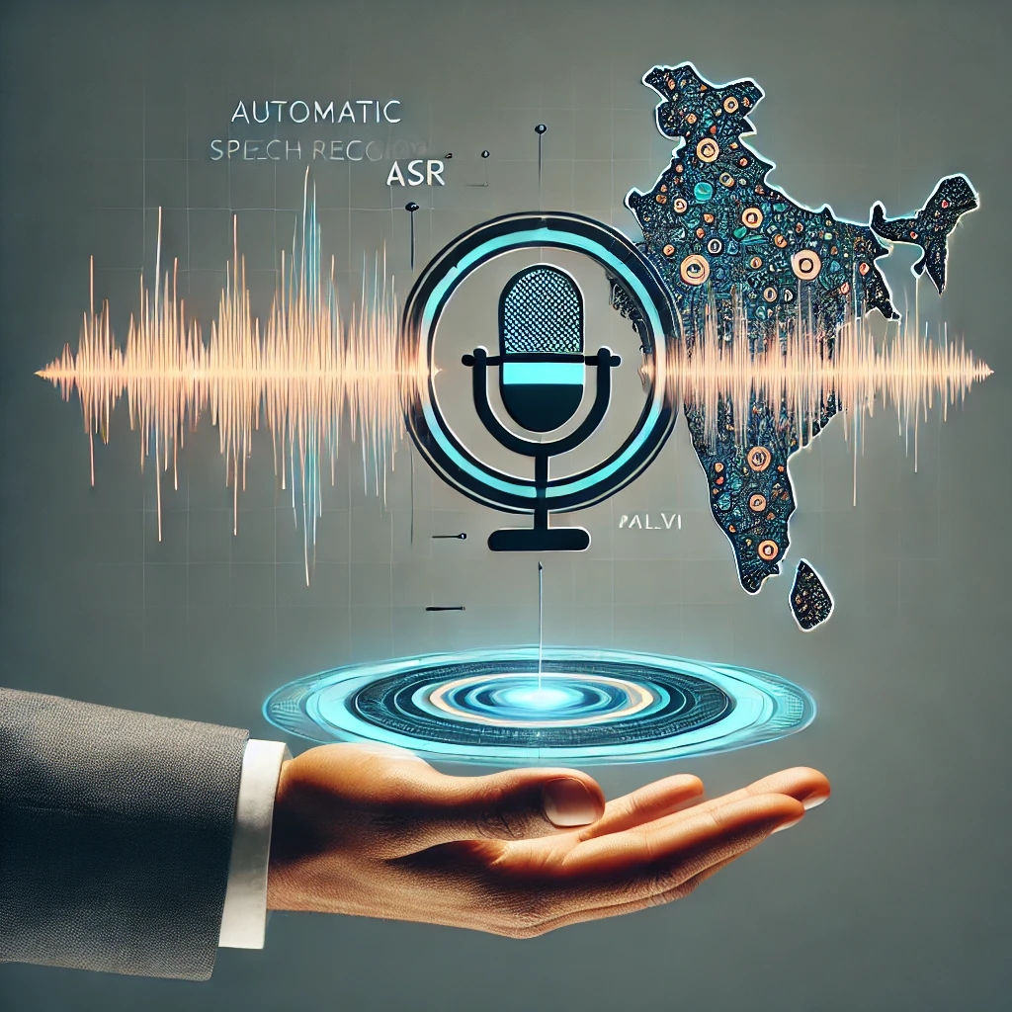
Objective
Develop an Automatic Speech Recognition (ASR) system for Malvi
Create an accurate transcription model by collecting a comprehensive corpus of Malvi audio and text data from native speakers.
Evaluate the ASR system's performance using Word Error Rate (WER) and Character Error Rate (CER) metrics..
.

Slide 9
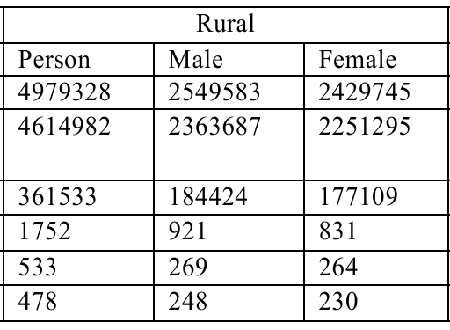
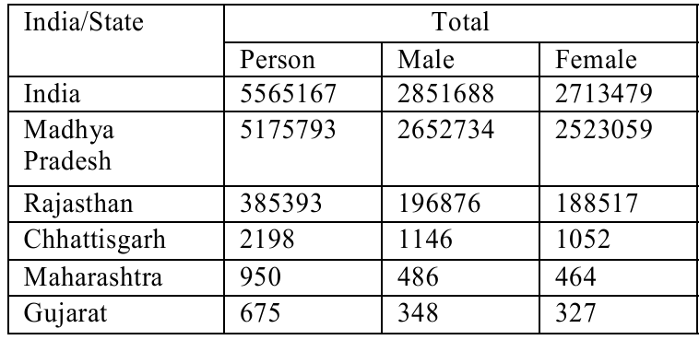

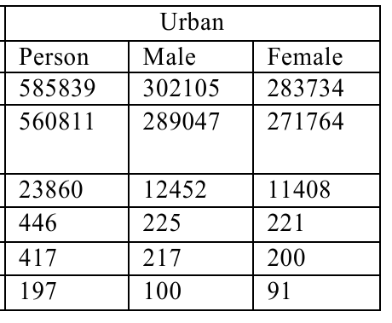
Malwa Speakers
2011 Census Rank: Malvi ranked 24th among mother tongues with over 1 million speakers in India.
Number of Speakers: 5,5,65,167 speakers, representing 0.43% of India’s total population.
Source
https://language.census.gov.in/eLanguageDivision_VirtualPath/LSI_Reports/pdf/5.pdf
CENSUS OF INDIA 2011
Wikipedia

Slide 10
Literature Review

Slide 11
Literature Review
No. | Tittle | Authors, Journal Year | Key finding | Limitations
1 | [1] An ASR Corpus in Chhattisgarhi, a Low Resource Indian Language | Authors: Abhayjeet Singh, Arjun Singh Mehta Journal/Conference: Speech and Computer (SPECOM 2023) Year: 2023 | 1.Effective method for creating a corpus | High Cost
2 | [2] Kazakh Speech Recognition: Wav2vec2.0 vs. Whisper [3] The Applicability of Wav2Vec2 and Whisper for Low-Resource Maltese ASR | Authors: Zhanibek Kozhirbayev Journal: Journal of Advances in Information Technology, Year: 2023 Authors: Aiden Williams, Andrea Demarco, Claudia Borg Conference: 2nd Annual Meeting of the ELRA/ISCA SIG on Under-resourced Languages (SIGUL 2023) Year: 2023, | Effective way to create ASR of low resource langauge –Kazakh& Maltese | Limited Unscripted Speech
3 | [4] Continuous Hindi Speech Recognition Using Kaldi ASR based on Deep Neural Network | Authors: Prashant Upadhyaya, Omar Farooq, Musiur Raza Abidi, Yash Vardhan Varshney Conference: IEEE WiSPNET 2017 Year: 2017 | Method of creating ASR | Limited Dataset Size:

Slide 12
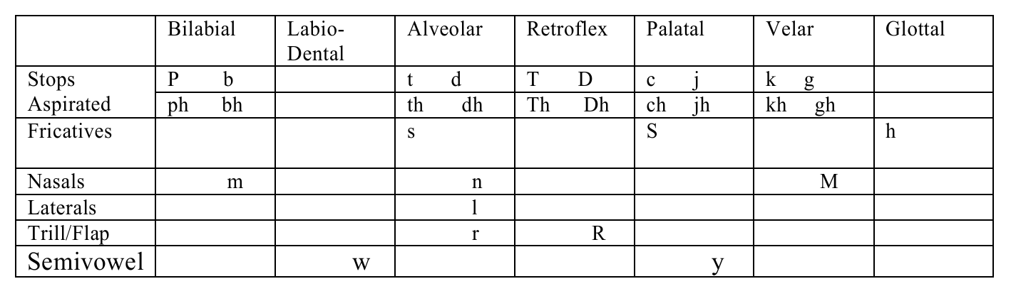
Malvi Phonemes
Malvi has 42 phonemes of which 11 are vowels and 31 are consonants. The supra segmental phonemes are Nasalization and length.
Vowels | Front | Central | Back
High | i i: |  | u u:
Mid | e e: | A | o o:
Low |  | a a:

Slide 13
Corpus Creation

Slide 14
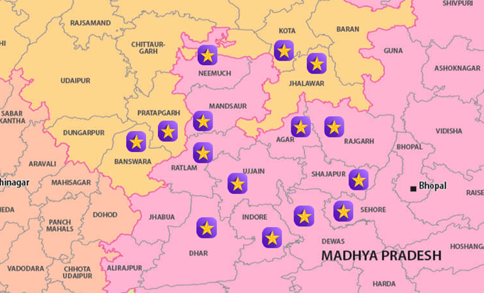



Corpus Creation
Speaker Demographics: 34 speakers from 10-15 distinct places.
Locations, including villages and districts within the Malwa region
Target Audience:
Gender: Male and Female
Age Group: 18 to 60 years old

Slide 15


Corpus Creation
District | Dialect | Remark
RAJGARH | Umadwadi
MANDSAUR | Sondhwadi
NEEMUCH | Rajwadi Malvi
RATLAM | Bhili Malvi ( influenced by local dialects)+Rajwadi
UJJAIN | Ujjaini (Malvi Proper)
AGAR | Sondhwadi Malvi
SHAJAPUR | Sondhwadi
DEWAS | Adarsh Malvi
SEHORE | Adarsh Malvi
DHAR | Adarsh Malvi
JHALAWAR | Sondhwadi
KOTA | Kota Malvi (variation influenced by local culture)
PRATAPGARH | Rajwadi Malvi (local variations)
BANSWARA | Bhili Malvi (with tribal influences)
Ujjaini (Malvi Proper) (Rakesh )
Spoken in: Ujjain, Dewas, Indore, Sehore, northern Dhar, southern Shajapur (MP).
Historical Impact: Capital of the Avanthi kingdom.
म्हारा यां सब मजा में हे
Rajwadi (Manish)
Spoken in: Nimuch, Mandsaur, Ratlam, parts of Indore (MP).
Historical Impact: Influenced by Rajasthani dialects due to Rajputana rule.
म्हारे अटे सब बढ़िया हे
Umadwadi (Manish)
Spoken in: Rajgarh district (MP).
Historical Impact: Named after the Umad Rajput clan.
म्हारा आडी सब बढ़िया हे
Sondhwadi (Laxmi)
Spoken in: Jhalawar (Rajasthan), northern Ujjain, north-western Shajapur, eastern Mandsaur, western Rajgarh (MP).
Historical Impact: Influenced by the Sondhia Rajput clan.
म्हारा अठे सब चोखो हे

Slide 16















Corpus Creation
Conversation Topics:
Sound Recording Technique
Recording Devices :
Conversation duration – 5- 10 minutes
Farming
Mobile Phone
File type -.wav
Education
Laptop
Audio Channel: Mono
Sports
File format : .wav file
Microphone
Election
File name: speakerId_recordingNo.wav

Slide 17
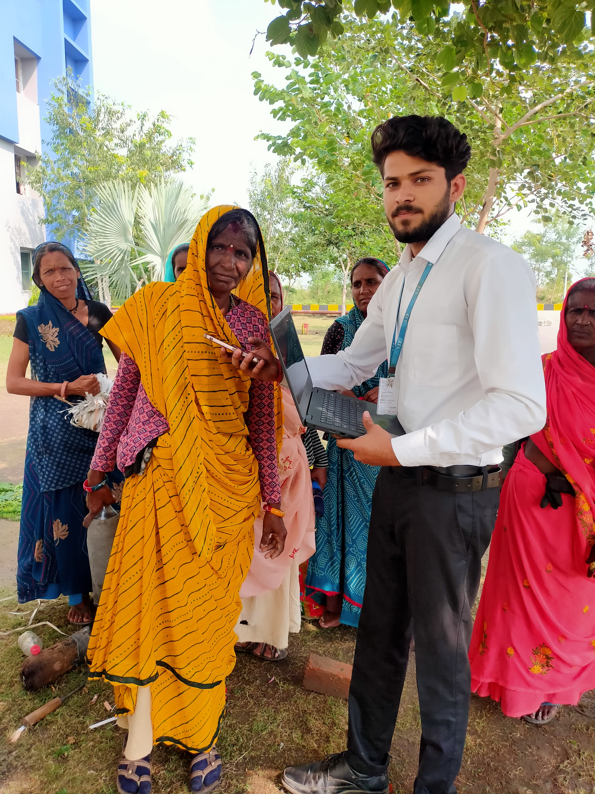
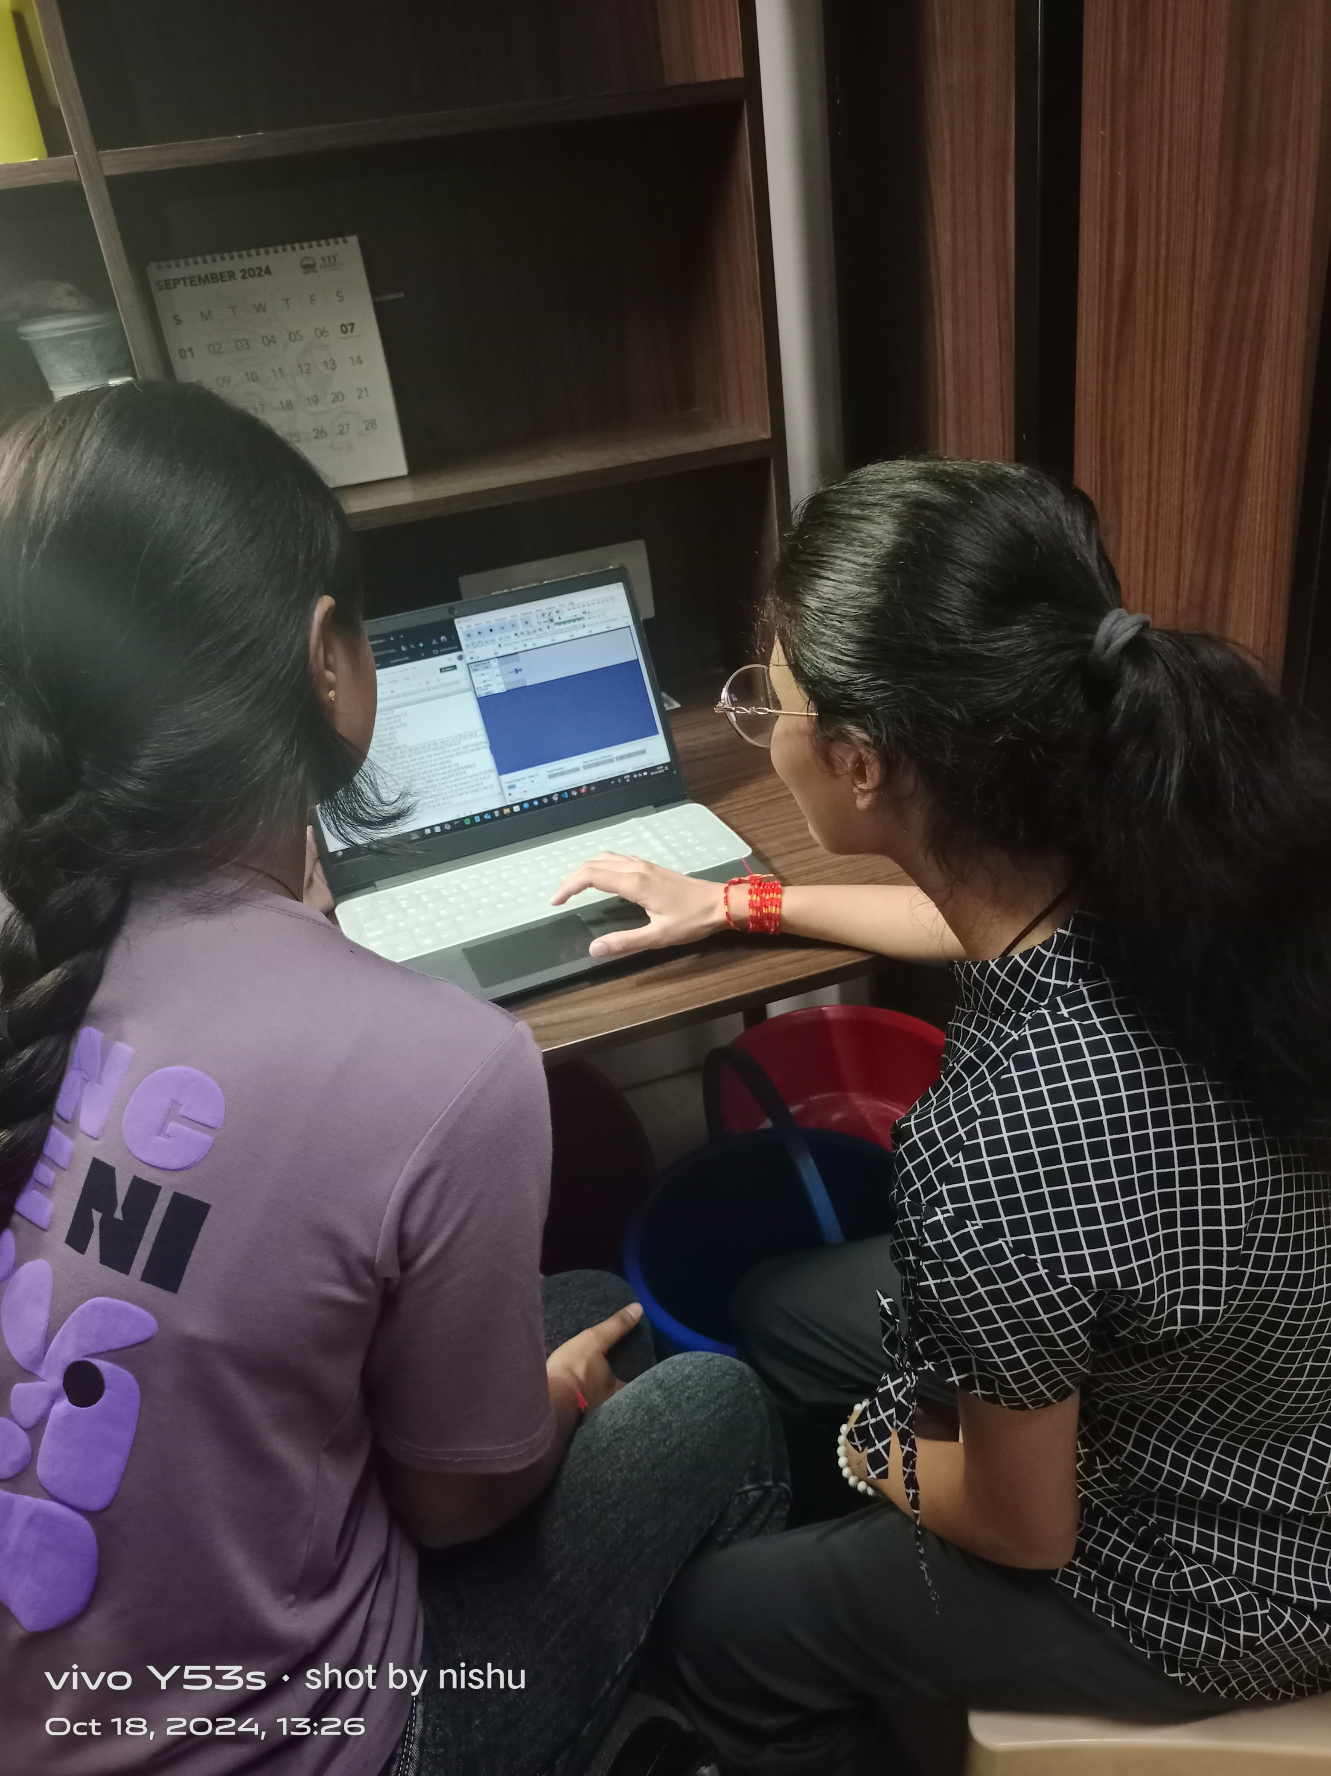
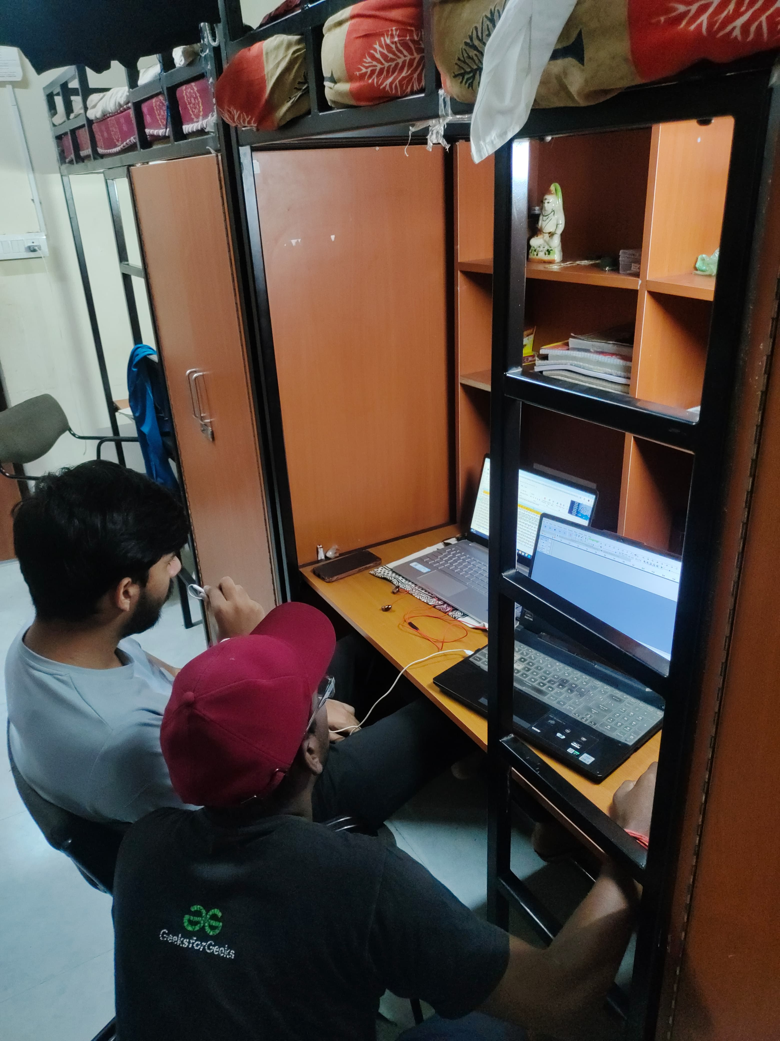
Ground Work

Slide 18
PHASE -2

Slide 19
Work Plan
ACTIVITY | TIME PERIOD | DURATION | OUTCOME
Task 1: Literature Review | Aug 2024 | 1 month | Study existing literature, their finding and limitations
Task 2: Problem Formulation and Identification | Sept 2024 | 1 month | Formulate proposed system and initial system design
Task 3: Corpus Creation | Oct – Dec 2024 | 2-3 months | Creating audio and text form data
Task 4: ASR Develop | January-March 2025 | 1 month | Implementation of simulated system on hardware platform
Task 5: Result analysis | April 2025 | 1 month | Testing and validation of proposed system

Slide 20
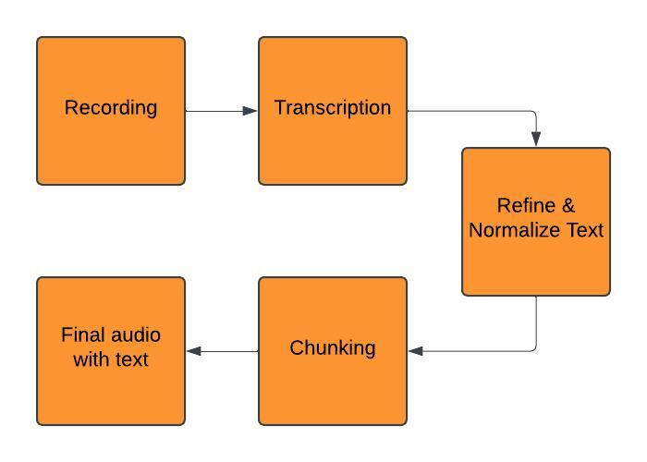
Data Collection
TextDate | TextDataLink
AudioData | AudioDataLink

Slide 21




Corpus Analysis
7.8 Hours
No of Speaker use –40
Female-19
Male- 21
Sentence – 2200
Text Corpus word- 19566
Unique Word- 4274

Slide 22

Corpus Analysis
Age Group | Male | Female | Total
18-30 | 9 | 7 | 16
30-45 | 6 | 8 | 14
45-60 | 6 | 4 | 10
English | Getting a government job in today's time is like finding a treasure in the times of our grandparents
Hindi | अब के समय में सरकारी नौकरी लगना मतलब दादा-दादी के समय में खजाना मिलने जैसा हो गया है
Malvi | अबे का जमाना में सरकारी नौकरी लगनो मतलब दादा सुन्ना को खजणो मिलनो जेसो हो गयो है
Recording / Audio

Slide 23
ASR Development

Slide 24
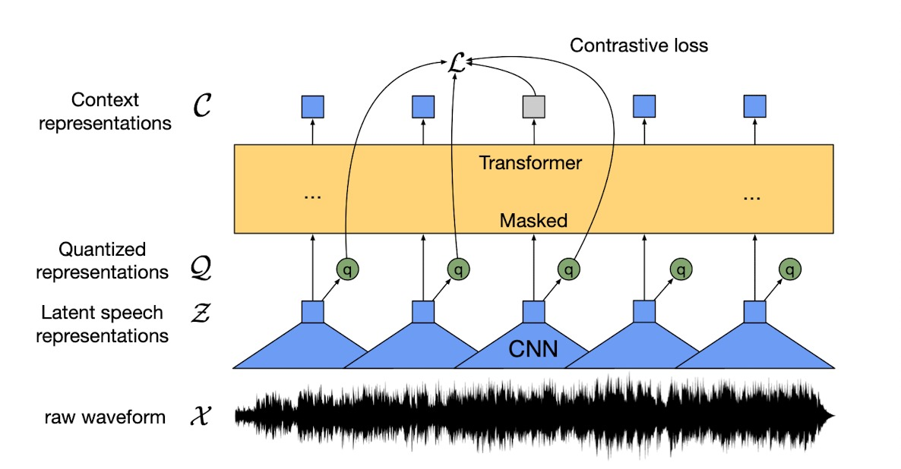

Methodology

Slide 25
Evaluation Parameter
Accuracy:
Word Error Rate (WER)-Measures transcription accuracy at the word level.
Word Error Rate = (Substitutions + Insertions + Deletions) / Number of Words Spoken.
Substitution: occurs when a word gets replaced (for example, “noose” is transcribed as “moose”)
Insertion: is when a word is added that wasn’t said (for example, “SAT” becomes “essay tea”)
Deletion: happens when a word is left out of the transcript completely (for example, “turn it around” becomes “turn around”).
Character Error Rate (CER)-Measures transcription accuracy at the character level.
Character Error Rate = (Substitutions + Insertions + Deletions) / Number of Character Spoken

Slide 26
Training Parameter
Platform Used: Google Colab
Model: Wav2Vec2.0
Training Configuration:
Epochs: 25
Batch Size: 6
Learning Rate: 3×10⁻⁴
Gradient Accumulation Step: 4
 | Train | Validation | Test | Total
Utterance | 800 | 100 | 100 | 1000
Duration (Minutes) | 170 | 21 | 21 | 212

Slide 27
Performance
The corpus is divided into test, train, and validation sets with a balanced gender proportion, following an 8:1:1 ratio.
Model |  | Validation | Test
Wav2Vec2.0 | WER | CER | WER | CER
Result | 44.21 | 14.6 | 46.36 | 15.33

Slide 28
Methodology
IndicWav2Vec
IndicWav2Vec: A multilingual speech model pretrained on 40 Indian languages.
Represents the largest diversity of Indian languages among multilingual speech models.
Fine-tuned for Automatic Speech Recognition (ASR) in 9 languages.
Achieves state-of-the-art results on three public benchmarks:
MUCS
MSR
OpenSLR
Created the largest publicly available corpora for 40 languages across 4 language families.
Trained state-of-the-art ASR models for 9 Indian languages.

Slide 29
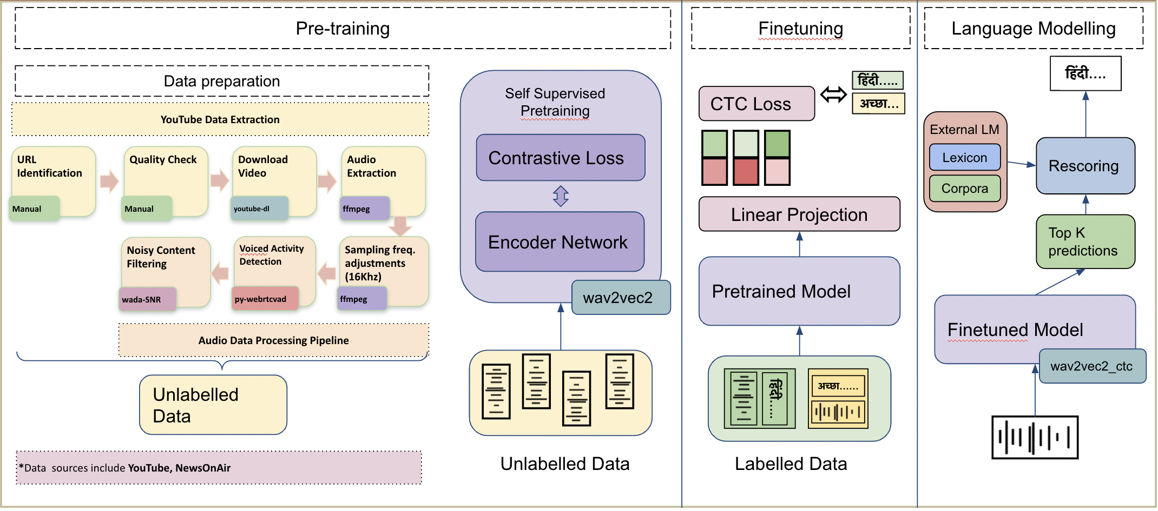
Methodology

Slide 30
Training Parameter
Platform Used: Google Colab
Model: IndicWav2Vec
Training Configuration:
Epochs: 25
Batch Size: 6
Learning Rate: 3×10⁻⁴
Gradient Accumulation Step: 4
 | Train | Validation | Test | Total
Utterance | 800 | 100 | 100 | 1000
Duration (Minutes) | 170 | 21 | 21 | 212

Slide 31
Performance
The corpus is divided into test, train, and validation sets with a balanced gender proportion, following an 8:1:1 ratio.
Model |  | Validation | Test
Wav2Vec2.0 | WER | CER | WER | CER
Result | 33.76 | 12.7 | 34.21 | 13.8

Slide 32
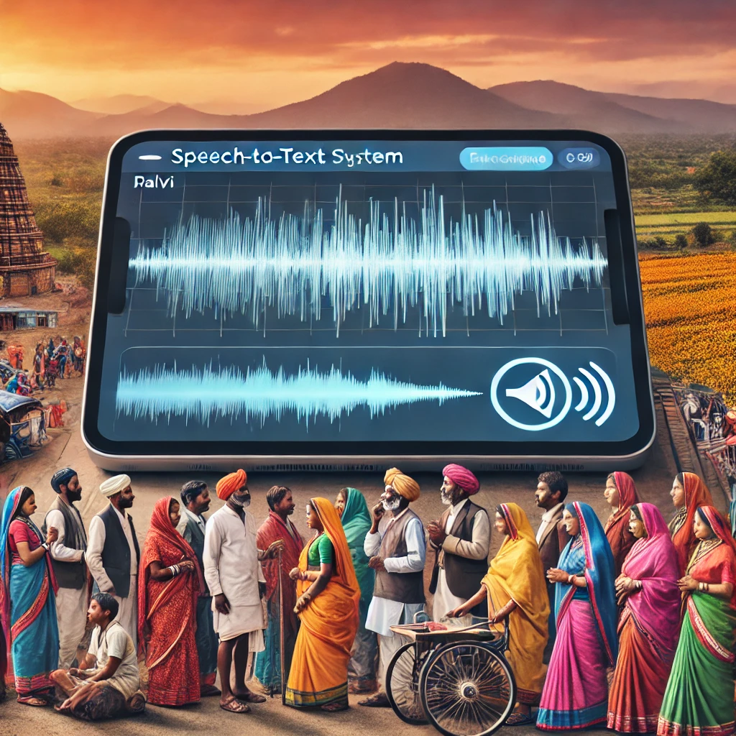
Conclusion
Current Progress:
Implemented Wav2Vec2.0 & IndicWav2Vec model on a 1000-sentence subset out of 2200 sentences.
Initial evaluation shows moderate results with WER and CER metrics.
Next Steps:
Expand Dataset: Use the full 2200-sentence dataset for improved training and evaluation.
Test Additional Models: Explore and apply other models (Fine-Tuning: Adjust hyperparameters (learning rate, batch size, epochs) for better accuracy.
Aim: Achieve improved WER and CER metrics

Slide 33
References
[1] A Singh, AS Mehta, KS Ashish Khuraishi, G Deekshitha, G Date, J Nanavati, J Bandekar, " An ASR Corpus in Chhattisgarhi, a Low Resource Indian Language", International Conference on Speech and Computer, 2023
[2] Kozhirbayev, Zhanibek. "Kazakh Speech Recognition: Wav2vec2. 0 vs. Whisper." Journal of Advances in Information Technology 14.6 (2023): 1382-1389.
[3] Williams, Aiden, Andrea Demarco, and Claudia Borg. "The Applicability of Wav2Vec2 and Whisper for Low-Resource Maltese ASR." Proc. 2nd Annual Meeting of the ELRA/ISCA SIG on Under-resourced Languages (SIGUL 2023). 2023.
[4] Upadhyaya, Prashant, et al. "Continuous hindi speech recognition using kaldi asr based on deep neural network." Machine Intelligence and Signal Analysis. Springer Singapore, 2019.
Census of India, 2011. Linguistic Survey of India (Volume 5). Retrieved from https://language.census.gov.in/eLanguageDivision_VirtualPath/LSI_Reports/pdf/5.pdf
Wikipedia

Slide 34

ThankYou
तमारो खूब खूब आभार

